Slide 1

Text Alignments
In Perseids
Gregory Crane, Anna Krohn, 2015

Slide 2
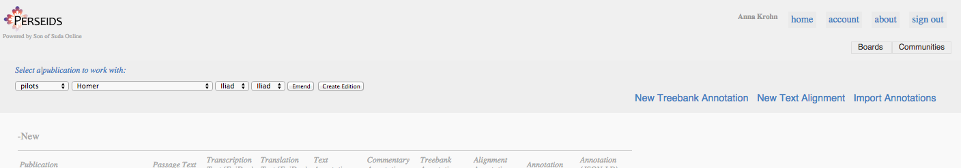
Starting a new Alignment
Notes:
http://sosol.perseids.org/sosol/user/user_dashboard

Slide 3
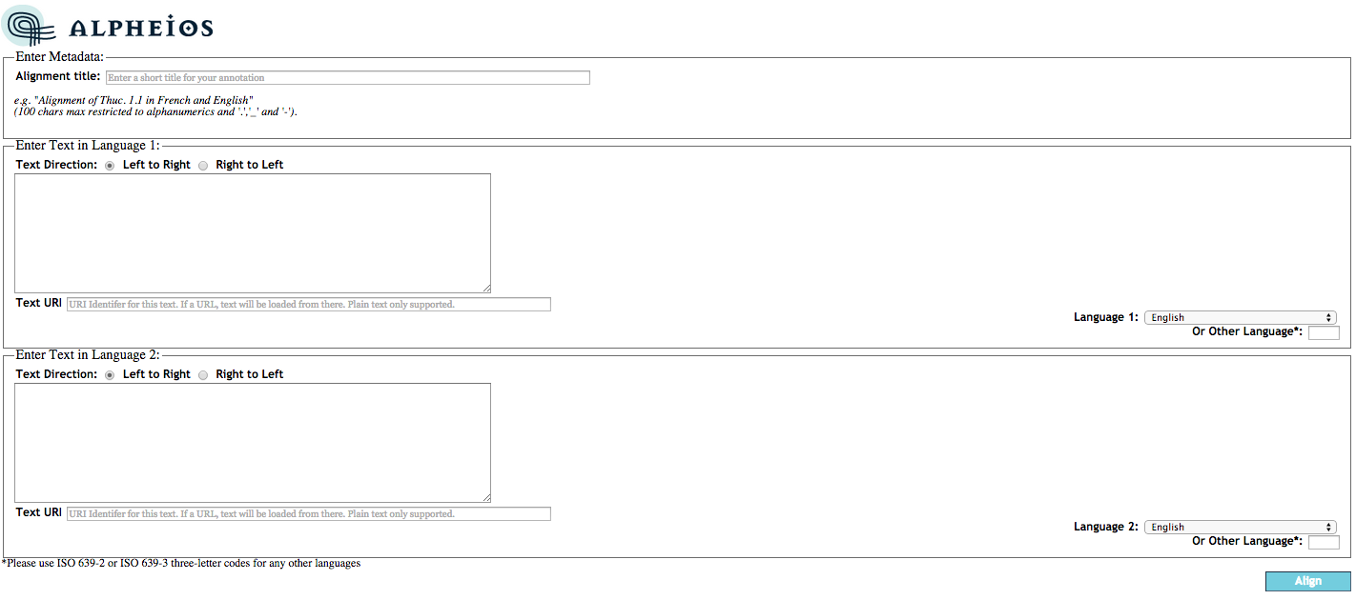
Enter Texts
Notes:
http://sosol.perseids.org/alpheios/app/align-entersentence-perseids.xhtml

Slide 4
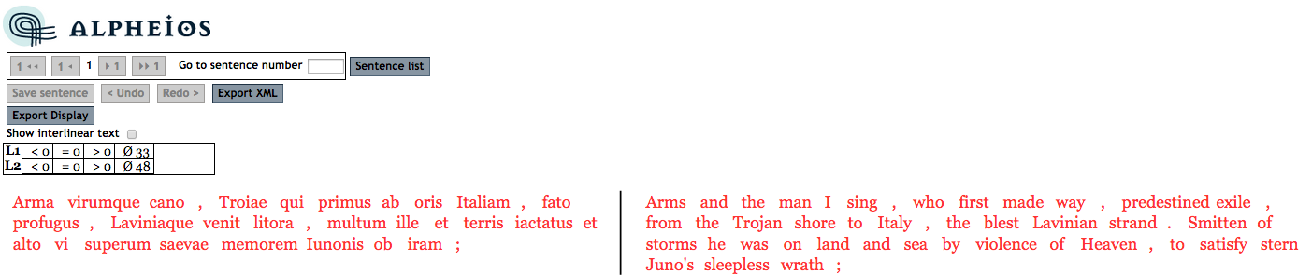
Beginning Alignment

Slide 5
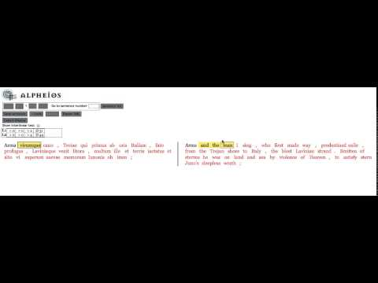
Aligning

Slide 6
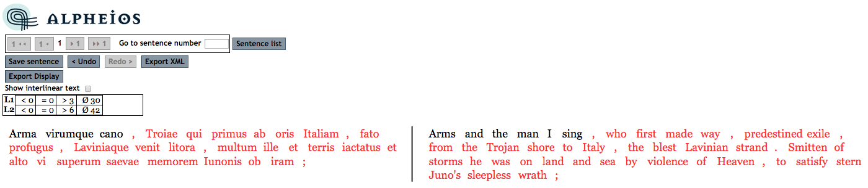
Save

Slide 7
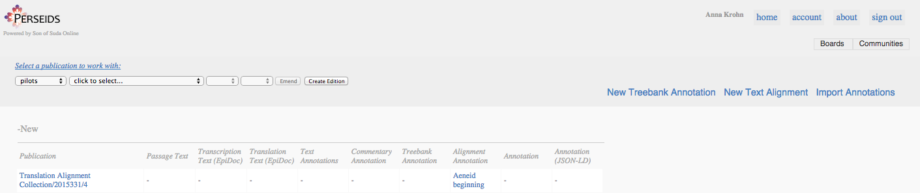
Back on the Dashboard

Slide 8
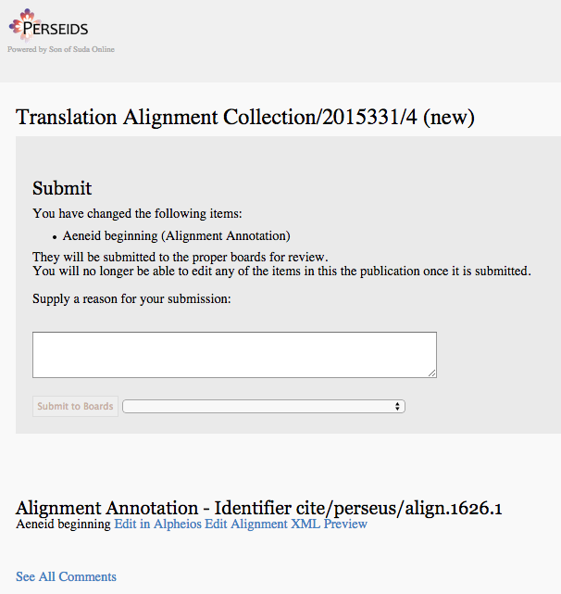
Sharing Alignments

Slide 9
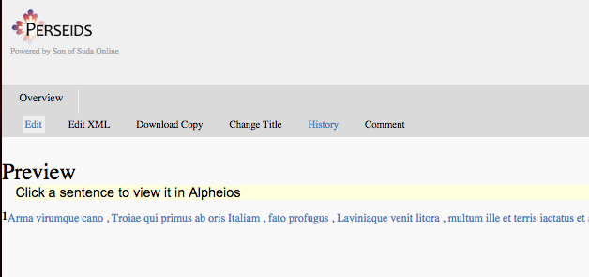
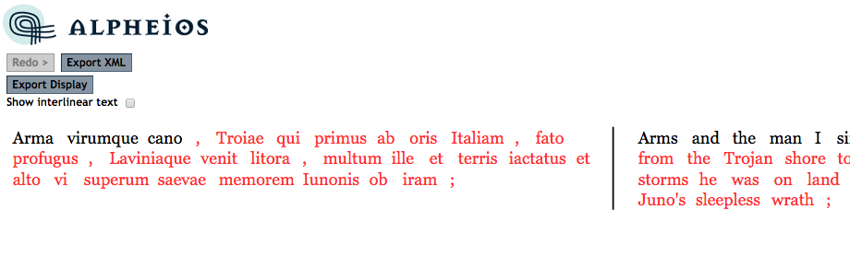
Sharing Alignments
http://sosol.perseids.org/alpheios/app/align-editsentence-perseids.xhtml?s=1&numSentences=1&app=viewer&doc=12227

